Slide 1

NSG Pilkington – University of Liverpool Machine Learning Project: 28/07/2021
Dr. Peter Green
Diego Echeverria
Sarini Jayasinghe
Risk Institute,
School of Engineering

Slide 2
Today
Differences between training and testing data
Gaussian Processes on large datasets
Testing script
Gaussian Process regression – order of relevance
Next steps

Slide 3
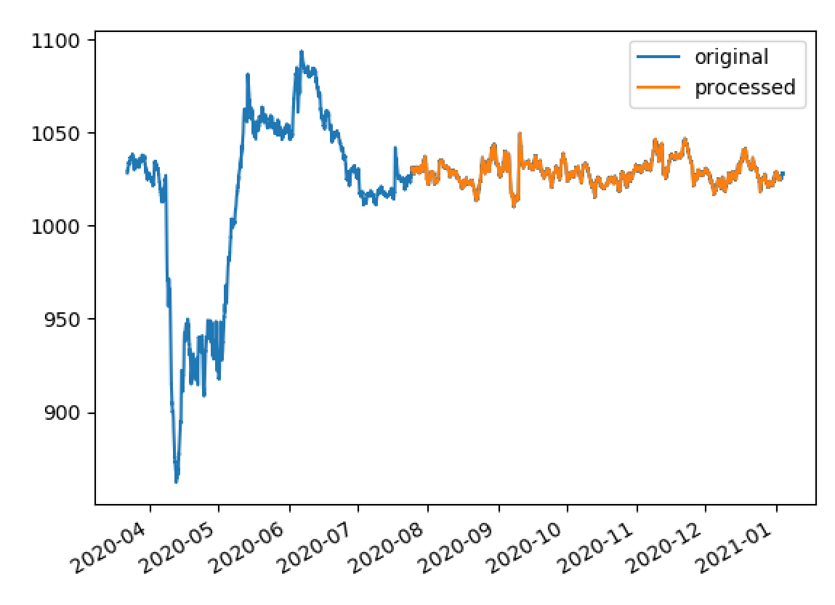
2913 Closed Bottom Temperature - Port 1 (PV)
The previous signal had been normalised in the figure (my fault!)
Range is now as expected (862 – 1093).
We are taking training data from the 25th July 2020 onwards.
Subsequently found that the third post-processed dataset contains one additional column of data that is not present in the others.

Slide 4
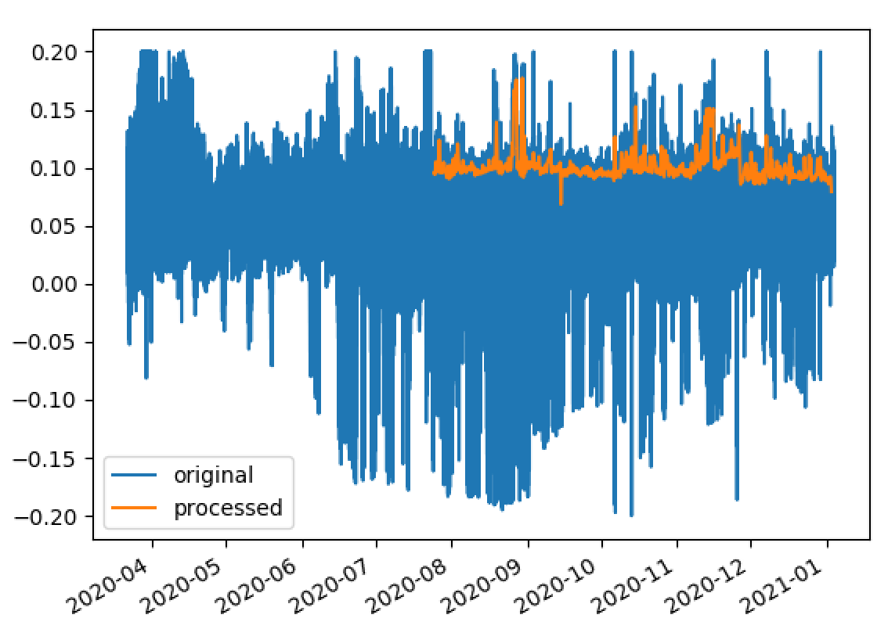
15119 Furnace Pressure (PV)
Range is now -0.2 to 0.2mbar.

Slide 5
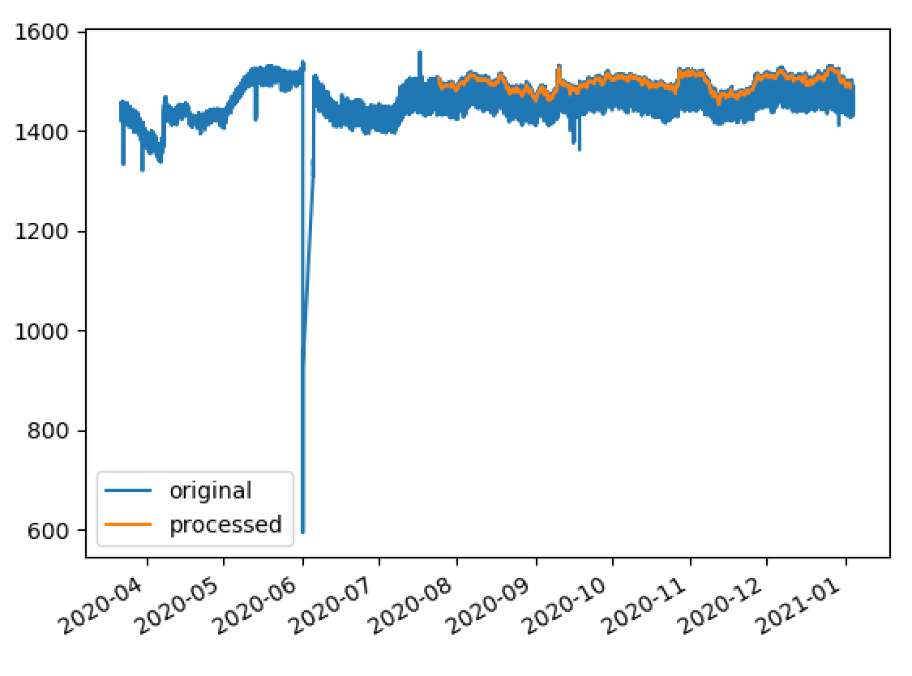
7546 Open Crown Temperature - Port 1 (PV)
Range is 1360 to 1560 (over selected training period).

Slide 6
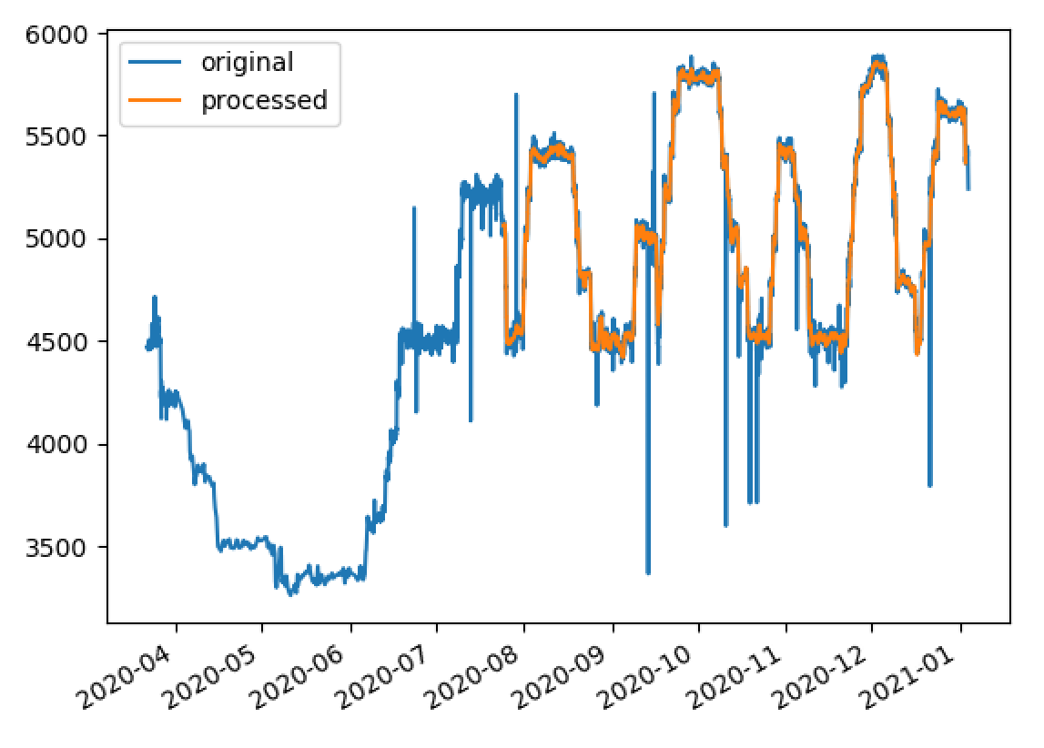
10091 Furnace Load
Around 4000-5800 with some outliers removed:

Slide 7
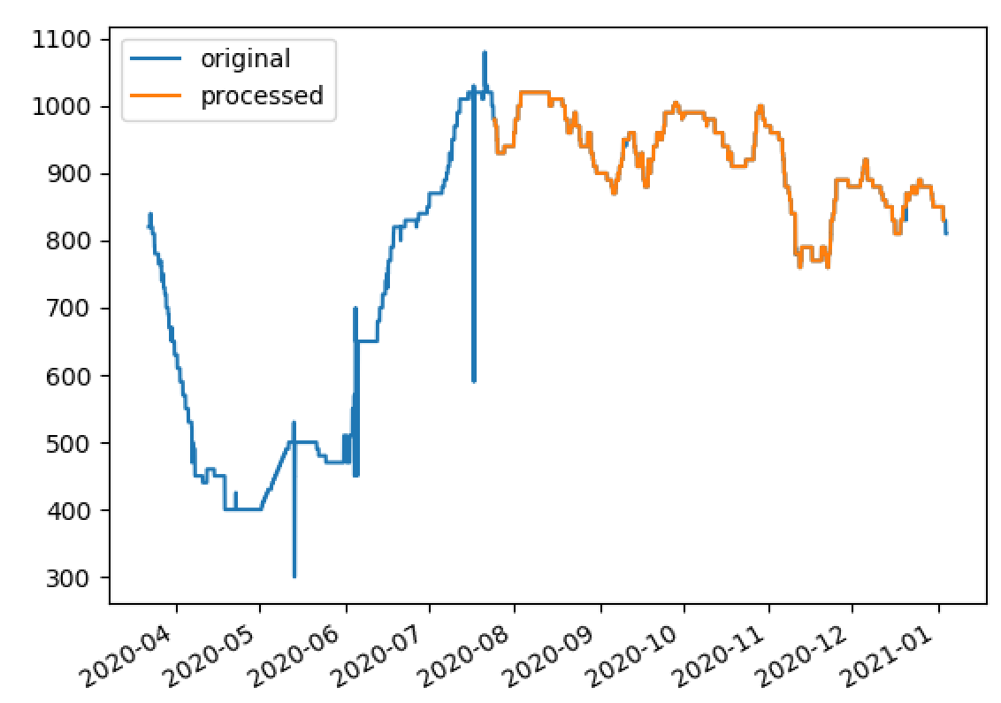
9400 Port 2 Gas Flow (SP)
800 – 1100 over the training period.

Slide 8
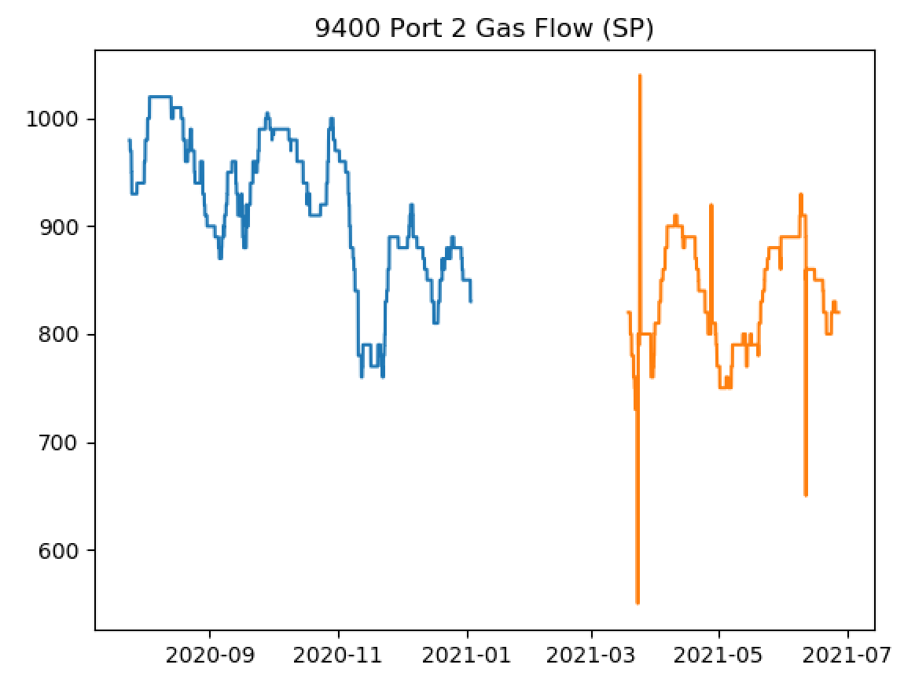
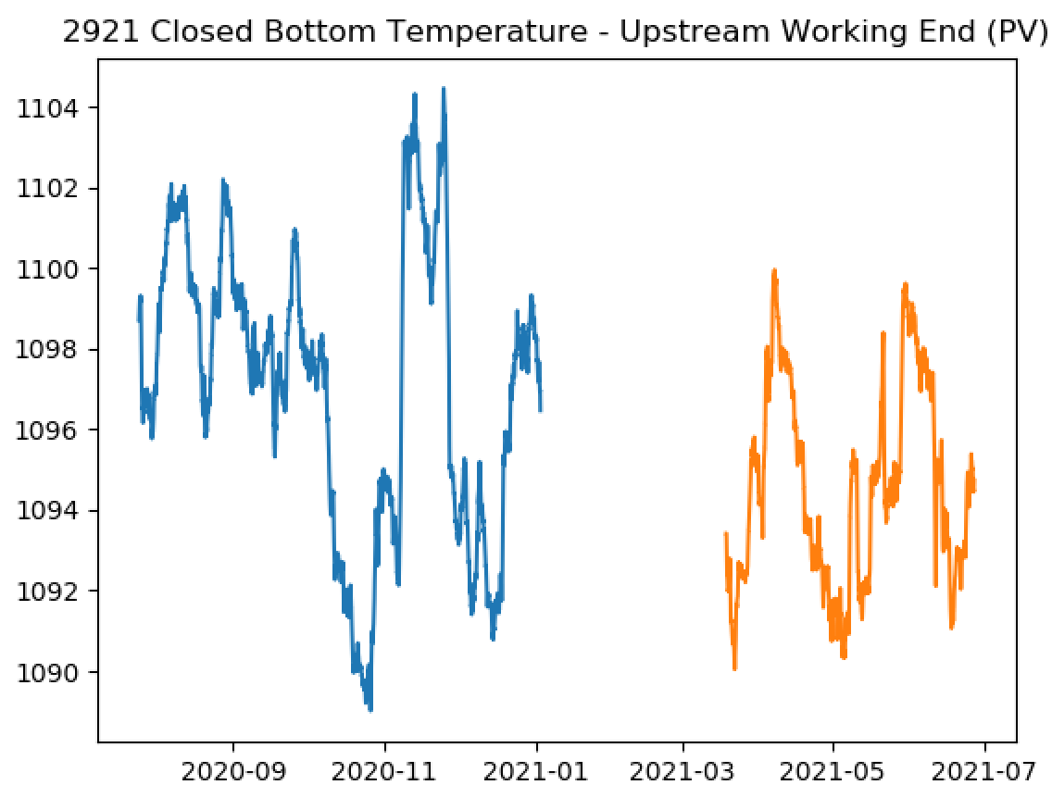
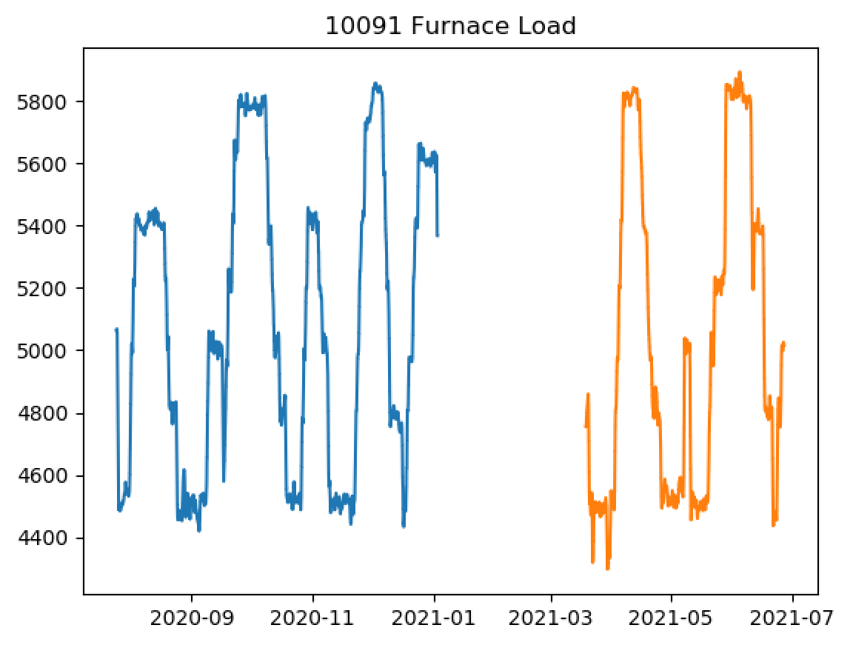
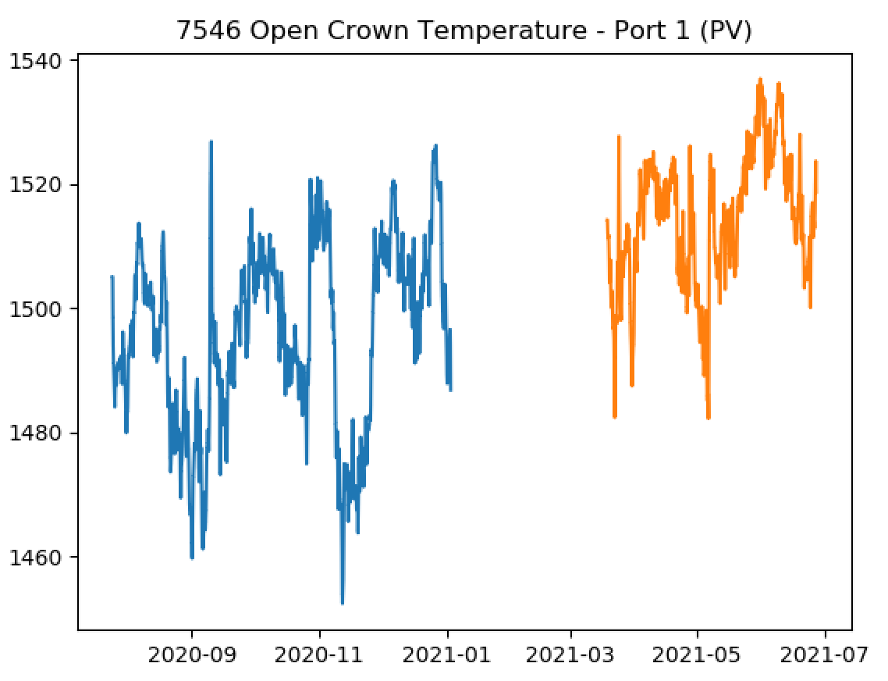
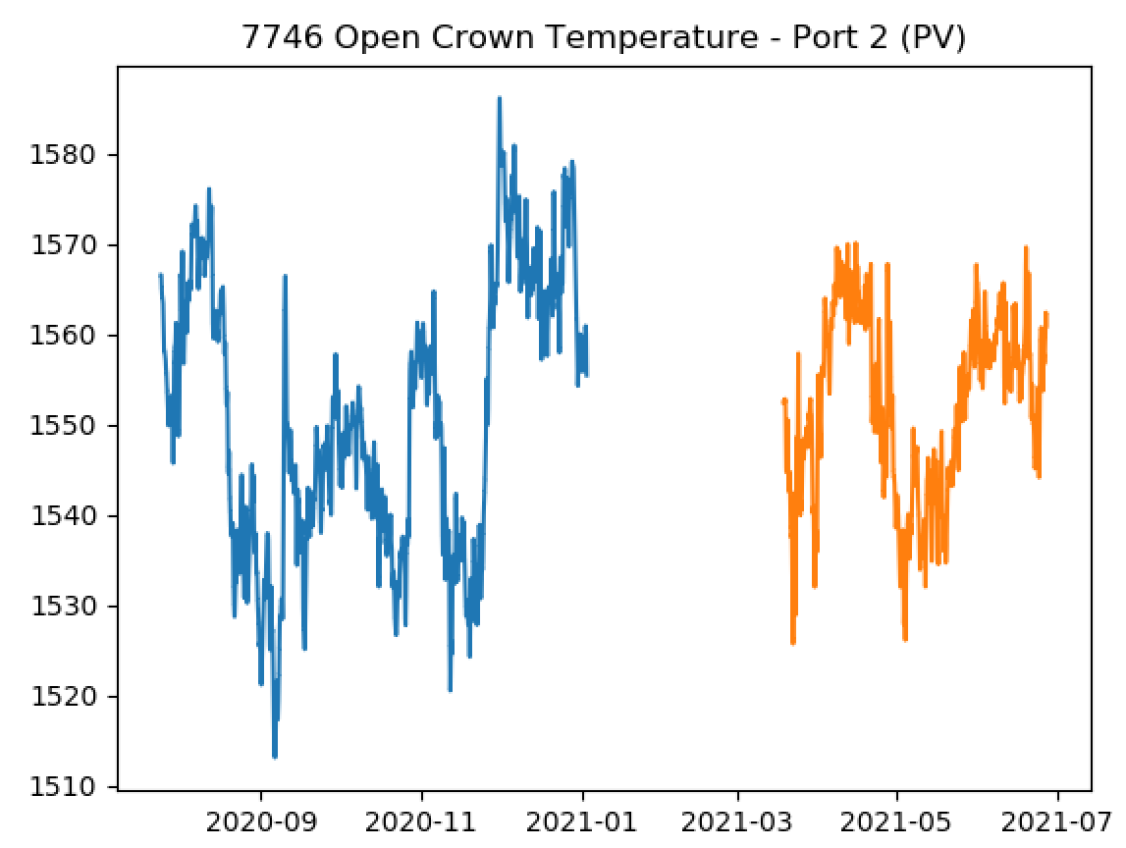
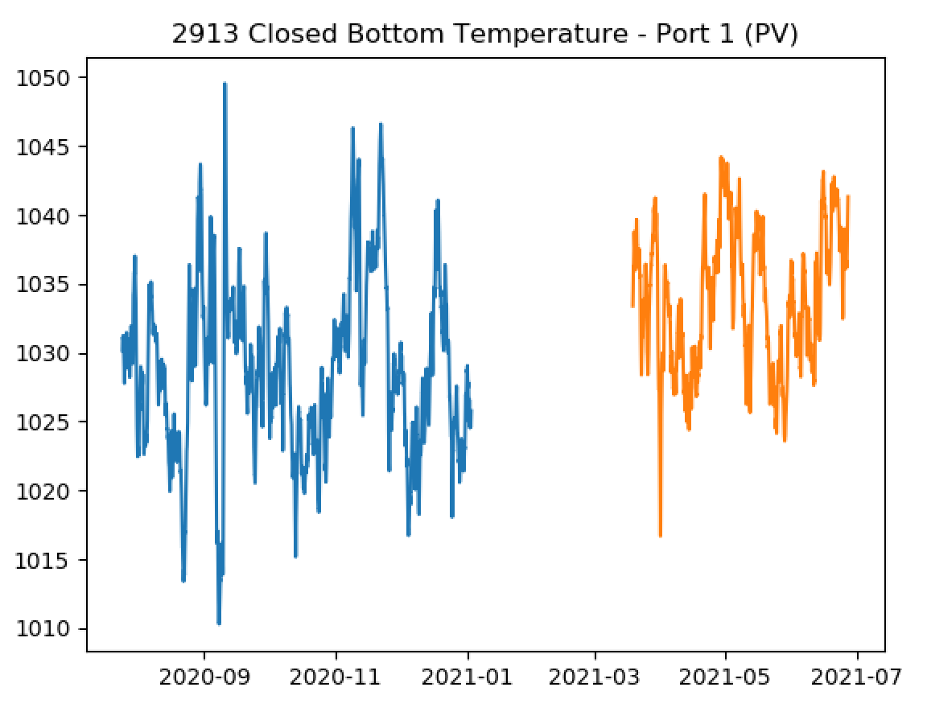
Differences between training and testing data

Slide 9
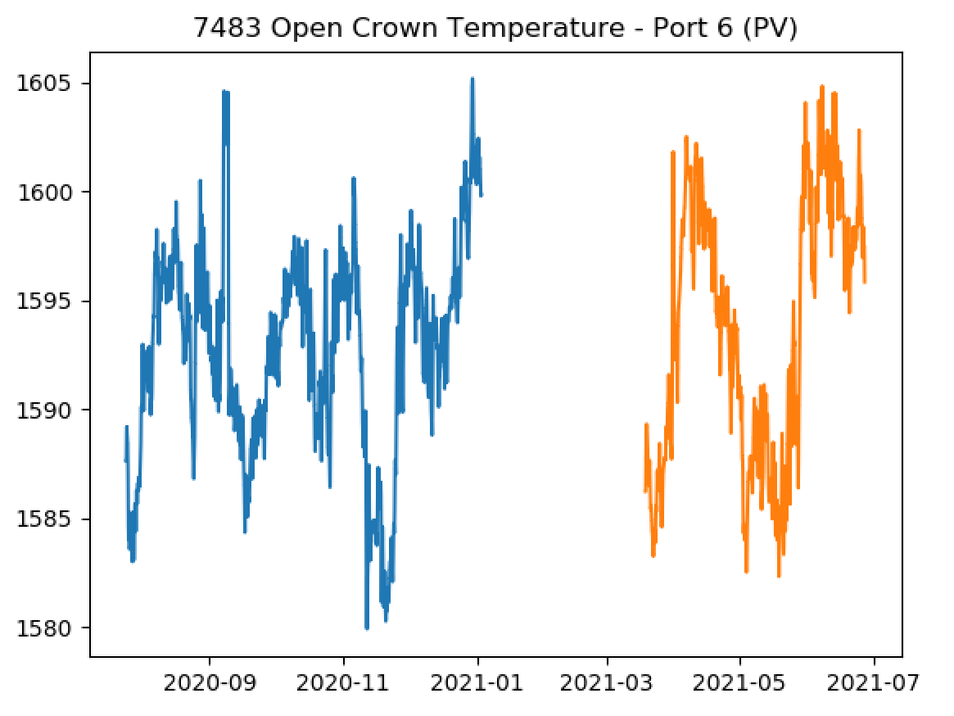
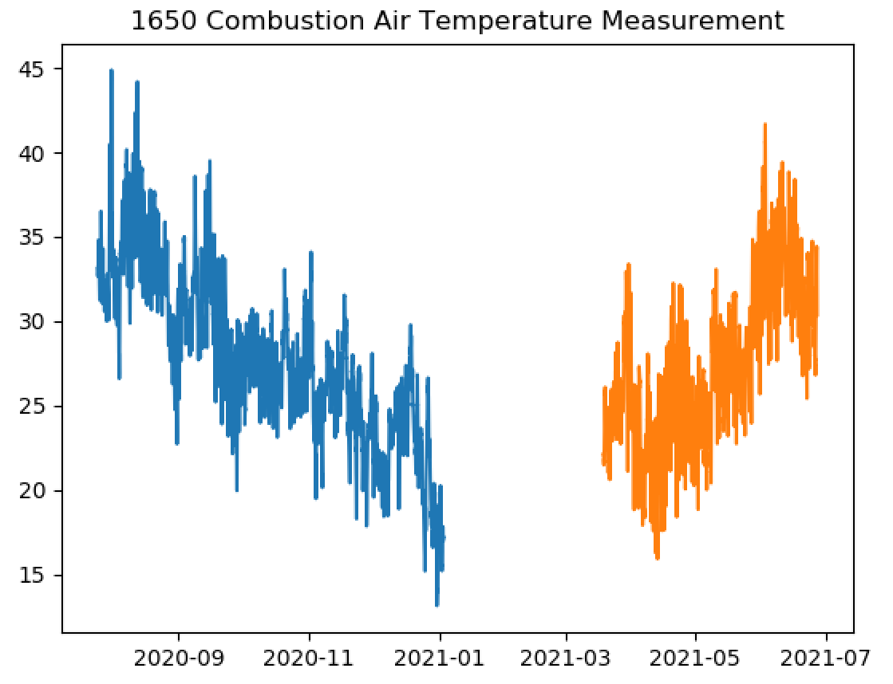
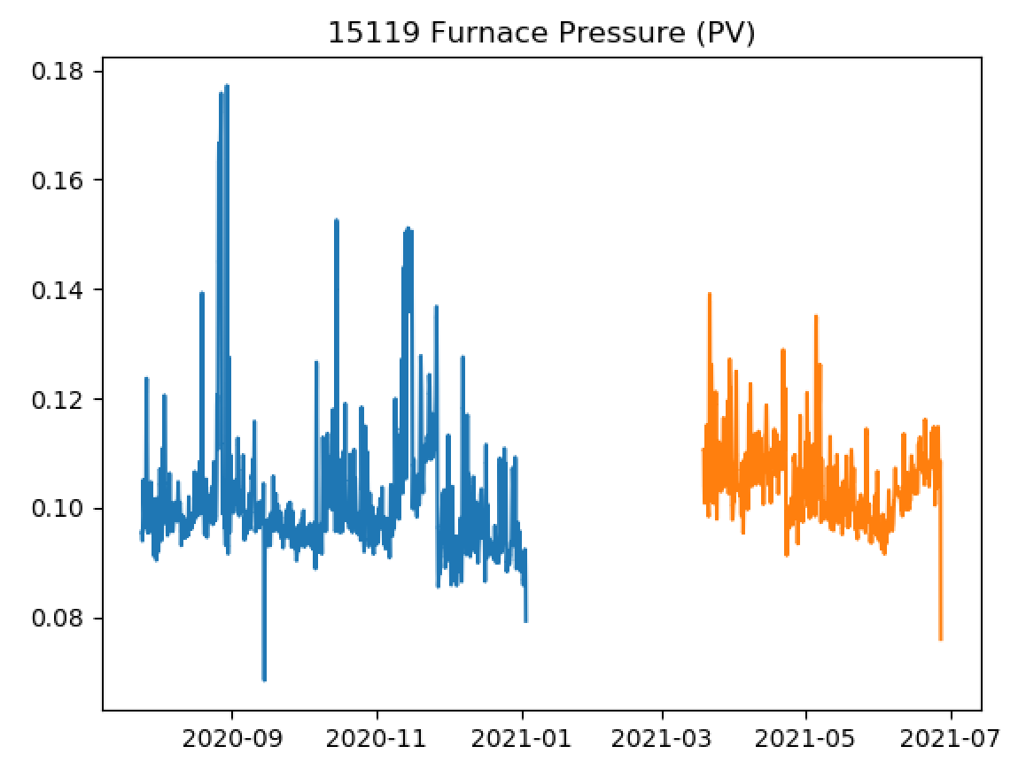
Differences between training and testing data

Slide 10
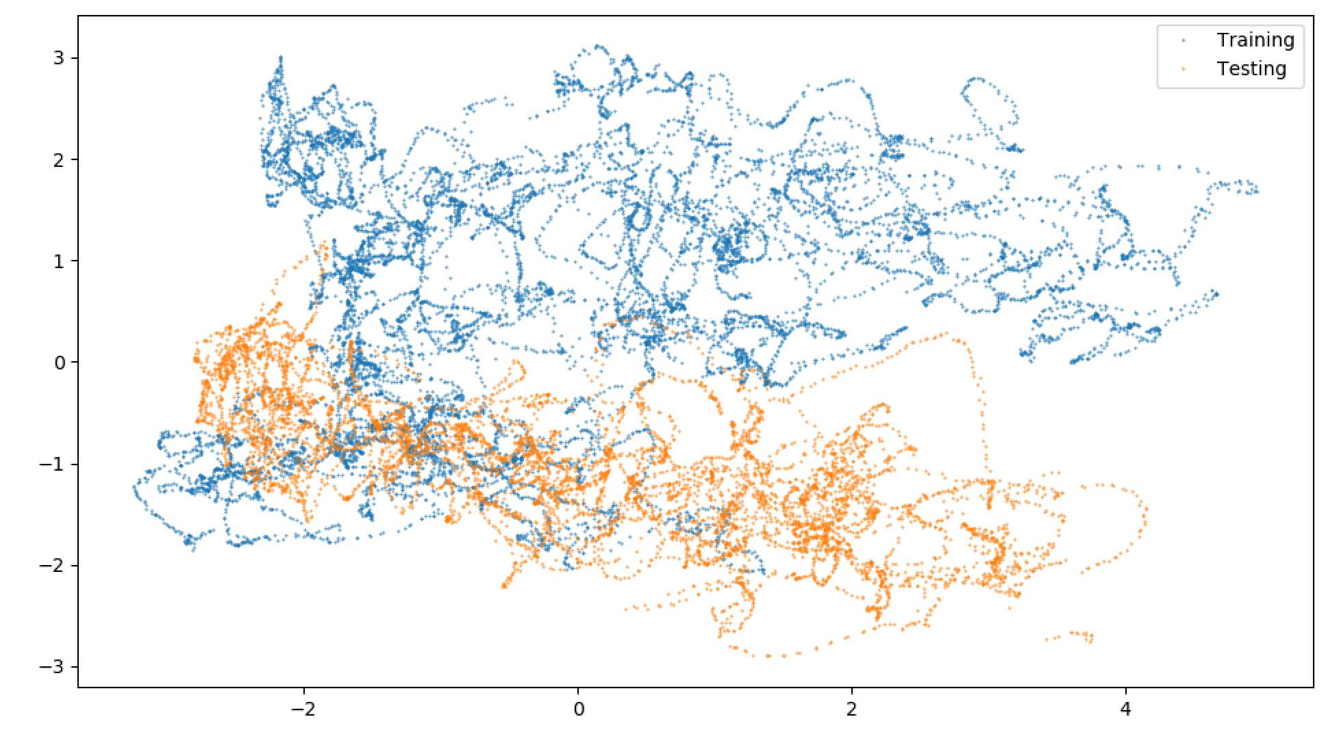
Differences between training and testing data
Actually, not as much overlap as might appear?

Slide 11
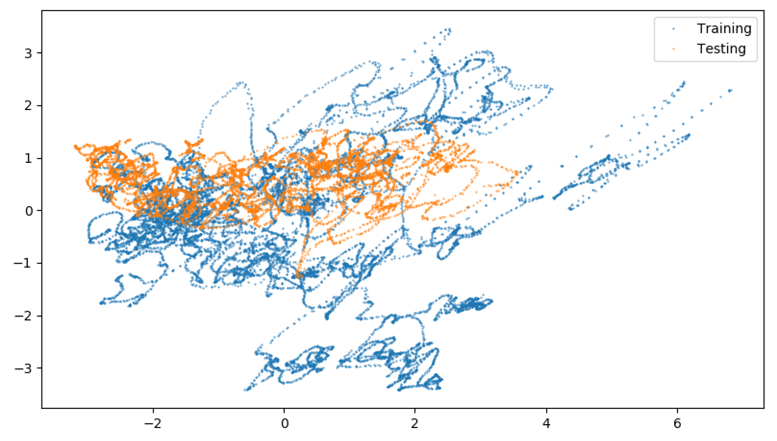
Differences between training and testing data
If we tried including all of the other data that has been sent to us:
This should be better… so more data is needed?

Slide 12
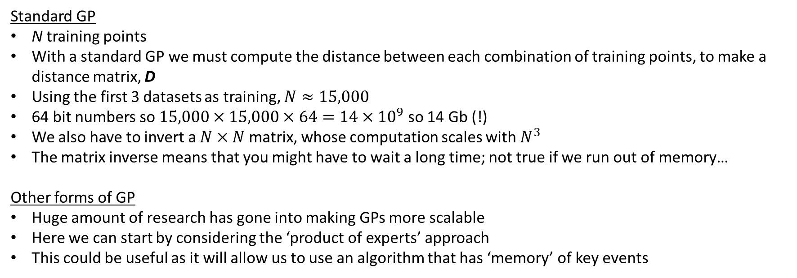
Gaussian Processes and Large Datasets
Standard GP
N training points
With a standard GP we must compute the distance between each combination of training points, to make a distance matrix, D
Using the first 3 datasets as training, $N≈15,000$
64 bit numbers so $15,000×15,000×64=14×{10}^{9}$ so 14 Gb (!)
We also have to invert a $N×N$ matrix, whose computation scales with $N^{3}$
The matrix inverse means that you might have to wait a long time; not true if we run out of memory…
Other forms of GP
Huge amount of research has gone into making GPs more scalable
Here we can start by considering the ‘product of experts’ approach
This could be useful as it will allow us to use an algorithm that has ‘memory’ of key events

Slide 13
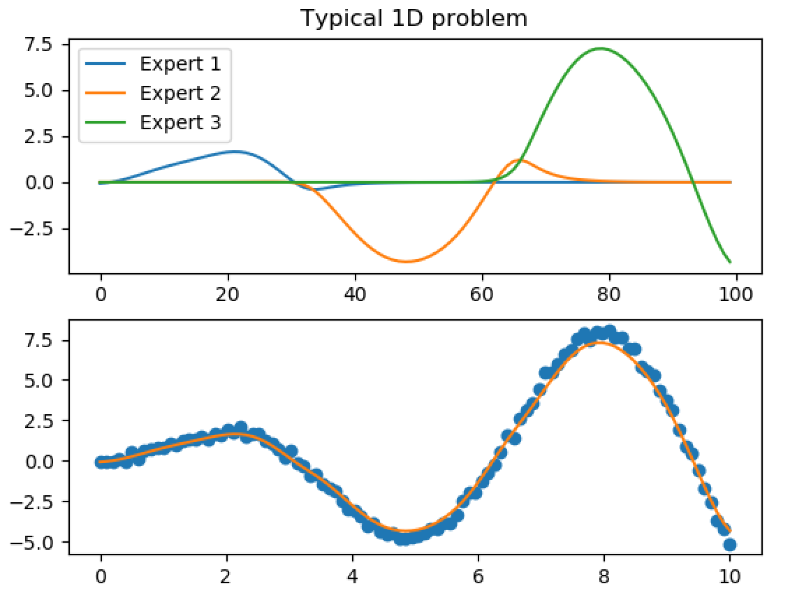
Product of Experts Gaussian Process
In brief, we divide up the training data into small subsets and each GP is trained only on a subset of the data.
In this way we realise local ‘experts’.
The full prediction is then made my multiplying the predictions of the experts.

Slide 14
Product of Experts Gaussian Process
We can keep an ‘expert’ at key rises in fault density that we have previously seen.
We could also decide to add another expert if the model has missed something important.
Unfortunately, the confidence bounds on PoE GPs tends to be overly optimistic.
There are ways around this [Deisenroth, M., & Ng, J. W. (2015, June)], but is probably a secondary issue?
Deisenroth, M., & Ng, J. W. (2015, June). Distributed gaussian processes. In International Conference on Machine Learning (pp. 1481-1490). PMLR.

Slide 15
Testing Script
The testing script was very complicated, so Sarini has developed a simpler version (now reviewed).
We did find a bug, though it’s not clear if this was in the original testing script.
Results now more like what I would expect (note that, here, PCA is applied to all of the inputs and not just the key inputs identified by the Gaussian Process).

Slide 16
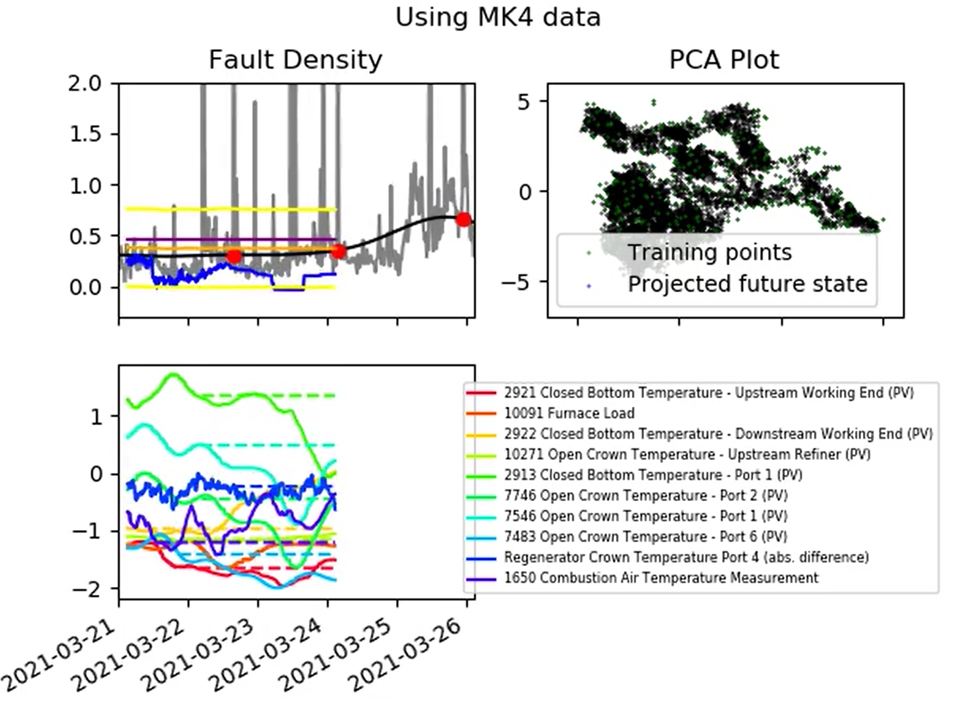
Testing Script
Initially furnace state isn’t visible on the PCA plot and the GP ‘flatlines’ as we would expect.

Slide 17
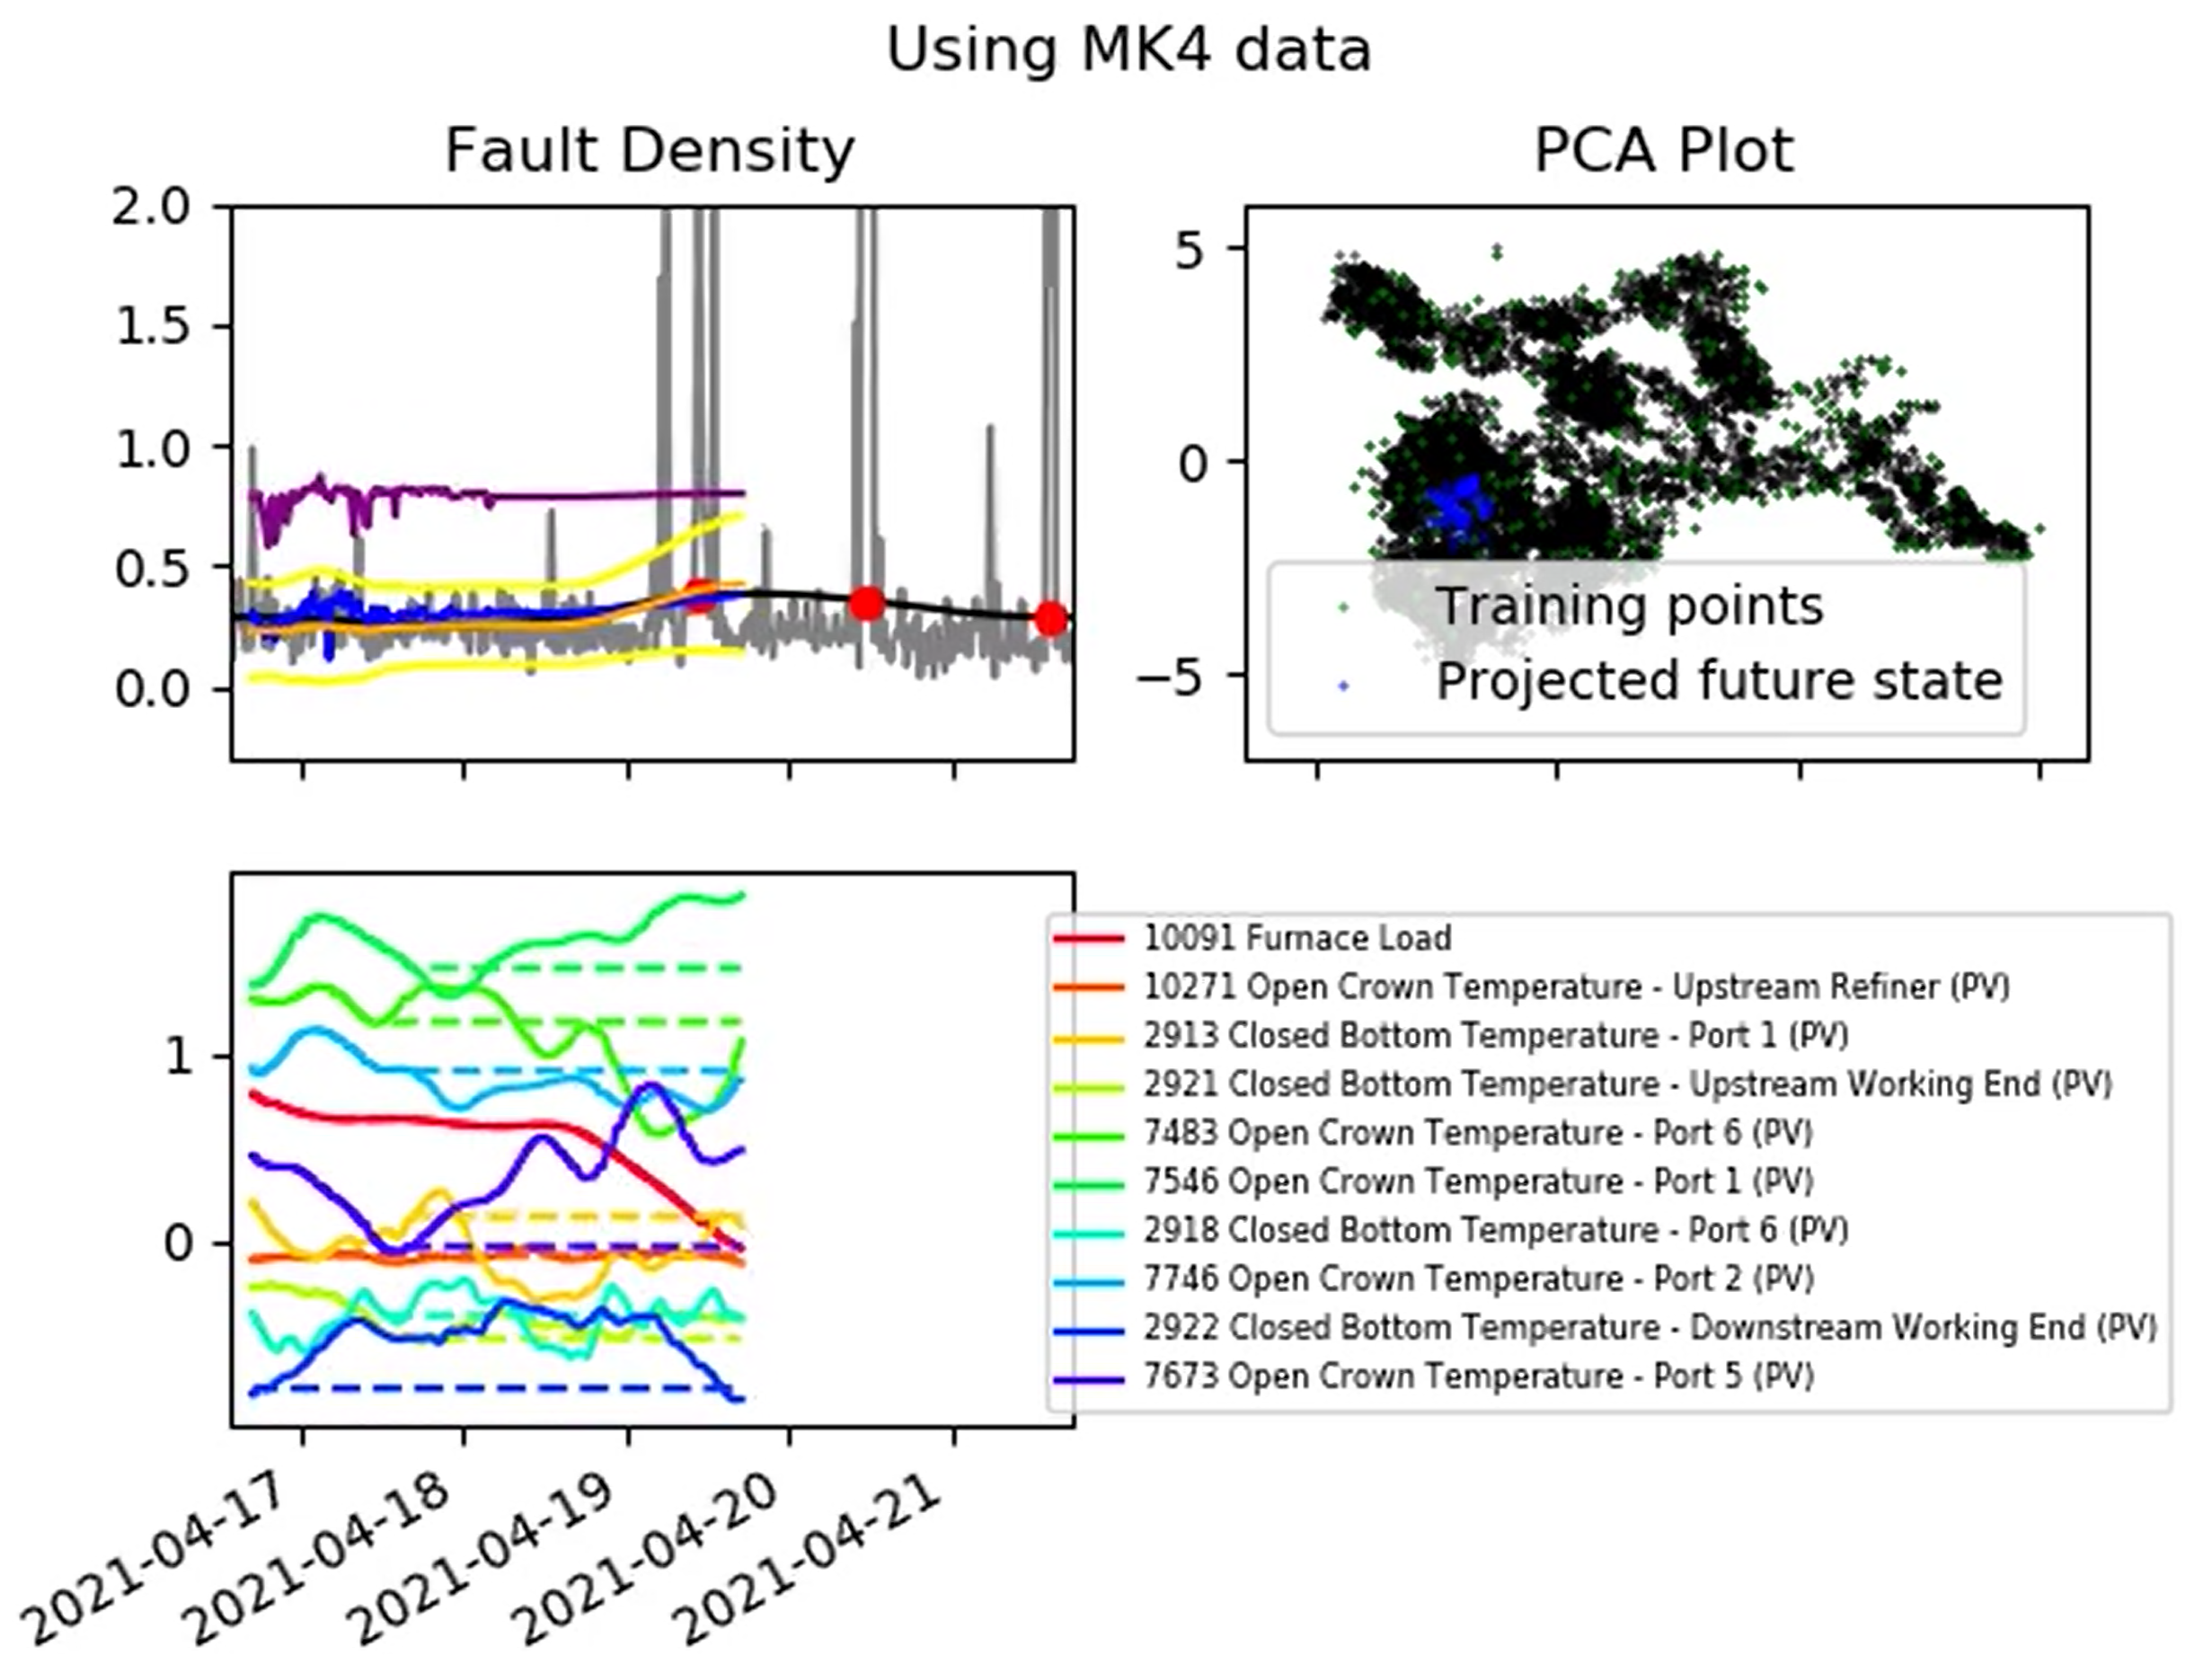
Testing Script
However, when we are close to training data, the GP behaves more like we would expect.
This figure is one of the highlights – 72 hour prediction of a rise in fault density.
Using more training data could really help us here (MoE GP).

Slide 18
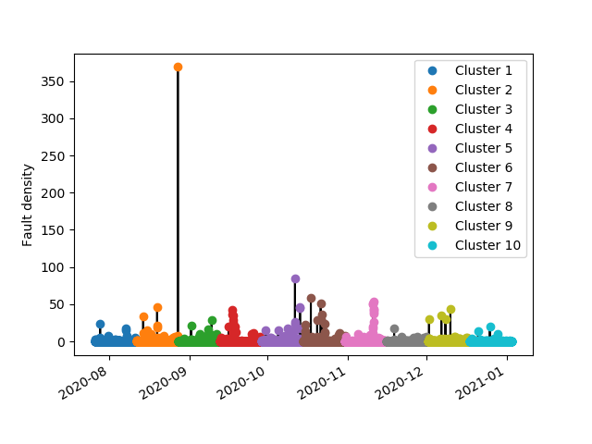
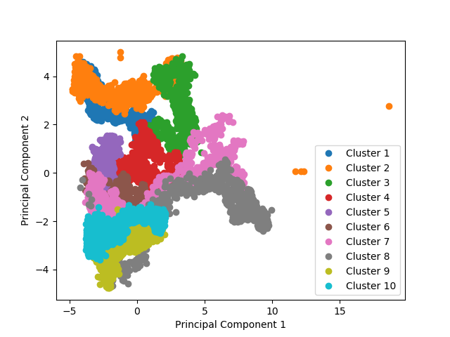
GP Regression- order of relevance
Clustering data along the time series to recognise the order of tag data relevance in different time periods

Slide 19
GP Regression- order of relevance
Data clustered along the time series (arbitrary)
For cluster 1, 3, 4 and 10 finding most relevant tag data was unsuccessful

Slide 20
GP Regression- order of relevance
Data clusters separated along the time series (arbitrary)
For cluster 1, 3, 4 and 10 finding most relevant tag data was unsuccessful

Slide 21
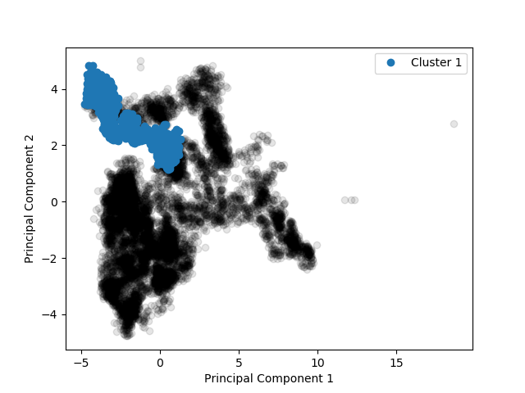
GP Regression- order of relevance
Order of relevance – cluster 1
2913 Closed Bottom Temperature - Port 1 (PV)
2922 Closed Bottom Temperature - Downstream Working End (PV)
7546 Open Crown Temperature - Port 1 (PV)
7746 Open Crown Temperature - Port 2 (PV)
Manual separation of data clusters along the time series

Slide 22
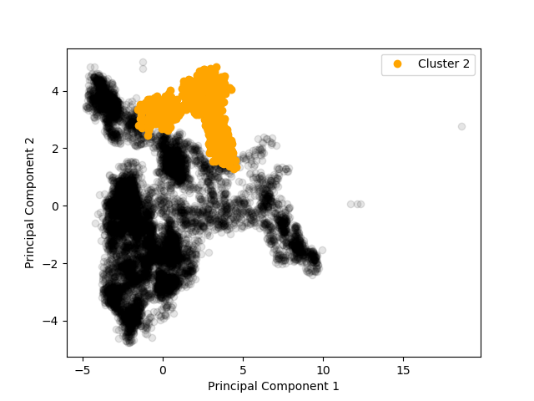
GP Regression- order of relevance
Order of relevance – cluster 2
2921 Closed Bottom Temperature - Upstream Working End (PV)
10091 Furnace Load
10271 Open Crown Temperature - Upstream Refiner (PV)
7483 Open Crown Temperature - Port 6 (PV)
Manual separation of data clusters along the time series

Slide 23
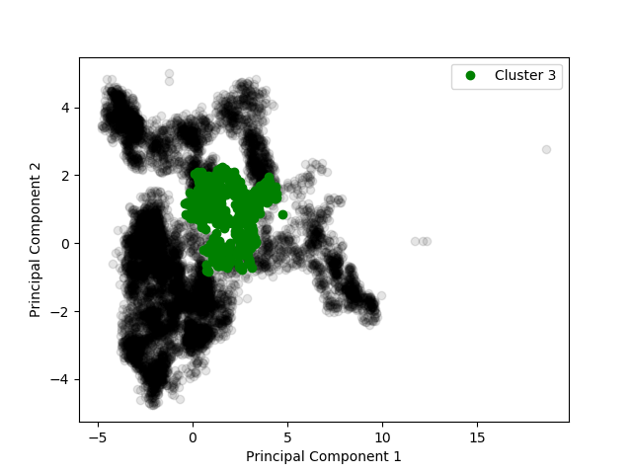
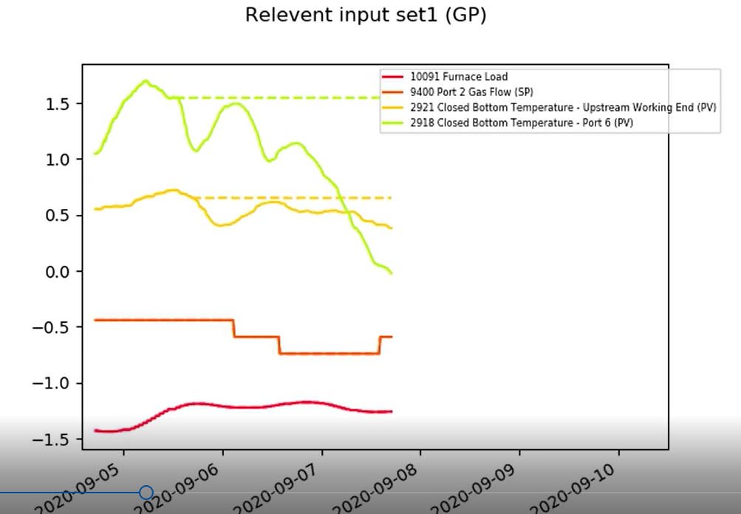
GP Regression- order of relevance
Order of relevance – cluster 3
2921 Closed Bottom Temperature - Upstream Working End (PV)
2922 Closed Bottom Temperature - Downstream Working End (PV)
10091 Furnace Load
2918 Closed Bottom Temperature - Port 6 (PV)

Slide 24
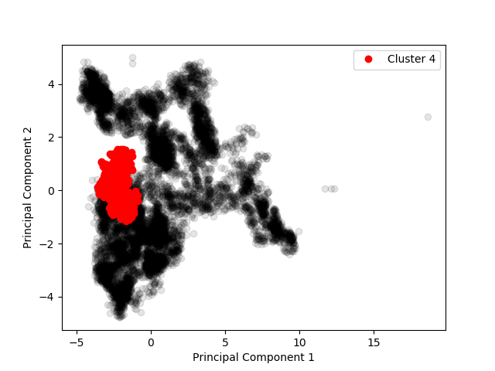
GP Regression- order of relevance
Order of relevance – cluster 4
2922 Closed Bottom Temperature - Downstream Working End (PV)
2921 Closed Bottom Temperature - Upstream Working End (PV)
200000 Front Wall Temperature Average (PV)
7673 Open Crown Temperature - Port 5 (PV)
Manual separation of data clusters along the time series

Slide 25
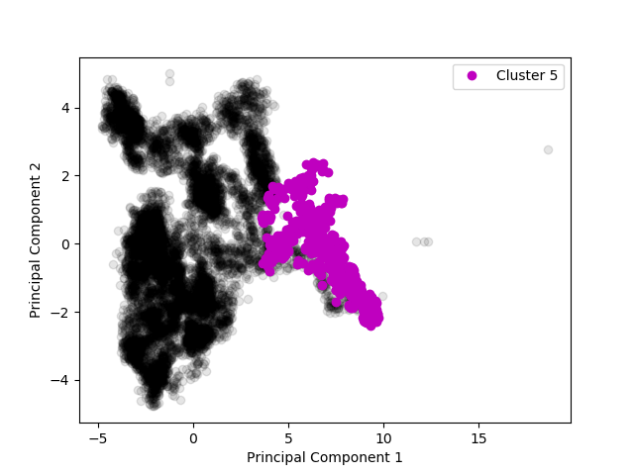
GP Regression- order of relevance
Order of relevance – cluster 5
10091 Furnace Load
2921 Closed Bottom Temperature - Upstream Working End (PV)
2922 Closed Bottom Temperature - Downstream Working End (PV)
200000 Front Wall Temperature Average (PV)
Manual separation of data clusters along the time series

Slide 26
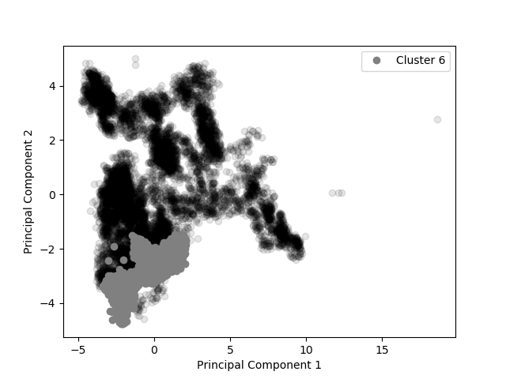
GP Regression- order of relevance
Order of relevance – cluster 6
10091 Furnace Load
10425 Calculated Cullet Ratio
2921 Closed Bottom Temperature - Upstream Working End (PV)
9400 Port 2 Gas Flow (SP)
Manual separation of data clusters along the time series

Slide 27
Next Steps
Implementation of PoE Gaussian Process model:
Using all of dataset 3 as training.
Using concatenation of datasets 1, 2, and 3 as training.
PCA only showing key inputs identified by the GP.
Including confidence bounds.

Slide 28
Thank you for your attention. ANY QUESTIONS?

